Slide 1
DAY 4

Slide 2


Simple or general linear model?
Here general refers to the dependence on potentially more than one explanatory variable (i.e. multiple linear regression), v.s. the simple linear model:
Cholesterol
age
age
exercise
Cholesterol
+

Slide 3

Simple or general linear model?
The model is linear in the parameters, e.g.
But not e.g.

Slide 4
General or generalized linear model?
Assumptions of GLM
Linearity
Independence
Normality
Equal variance
There are situations where, general linear models are inappropriate:
The range of Y is restricted (e.g. binary, count)
The variance of Y depends on the mean
Generalized linear models extend the general linear model to address these issues
LINE

Slide 5
General or generalized linear model?
A generalized linear model is made up of a linear predictor = relates mean to predictors
and two functions:
a link function (transform done on Y) = relates means of observations to predictors
a variance function (the distribution) = relates the means to the variances
age
exercise
Cholesterol
+

Slide 6
Poisson Regression or Regression of Counts (& Rates) is a Generalized linear model

Slide 7
Poisson Regression is a generalized linear model: linear predictor = η link function (transformation) = log transform variance function (the distribution) = V (μ) = μ

Slide 8
Poisson Regression or Regression of Counts (& Rates)

Slide 9

Poisson regression

Slide 10
Poisson Regression is a generalized linear model: linear predictor = η link function = log transform variance function = V (μ) = μ

Slide 11

Poisson regression

Slide 12
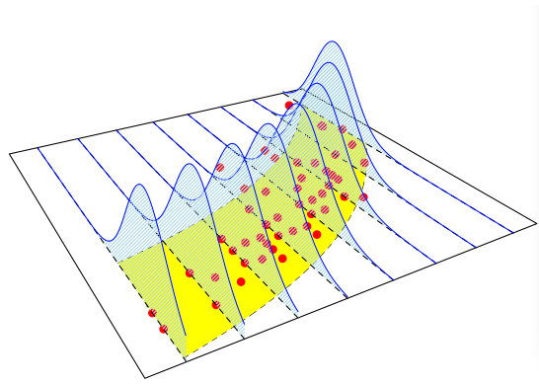
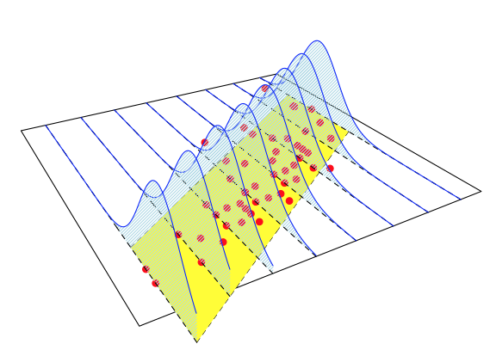
Poisson regression
Linearity*
Independence
Normality*
Equal variance*
Extends GLM to account for non-linearity and heteroscedasticity

Slide 13
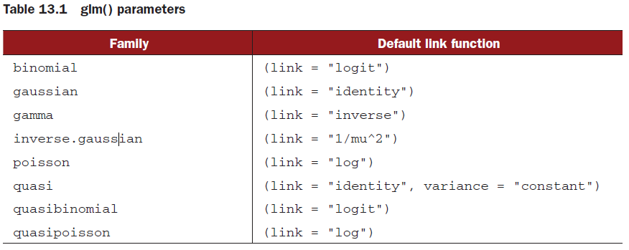
Link function – Poisson regression
poisson.model = glm(Y~x1+x2+…Xn,data=dataframe,
family=poisson(link=“log"))

Slide 14
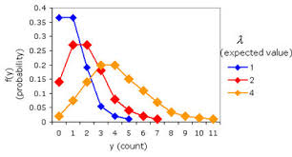
Poisson distribution (discrete probability distribution)
Not a single shape
Described by a single parameter (mean - lambda)
The mean = variance
As the mean increases the distribution spreads out

Slide 15
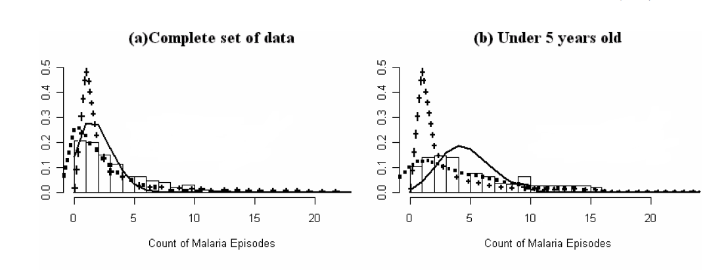
Poisson regression (Mwangi et al)
What is the difference in malaria episodes in children < 5 yrs. and all children (including > 5 yrs.) in Kilifi?

Slide 16
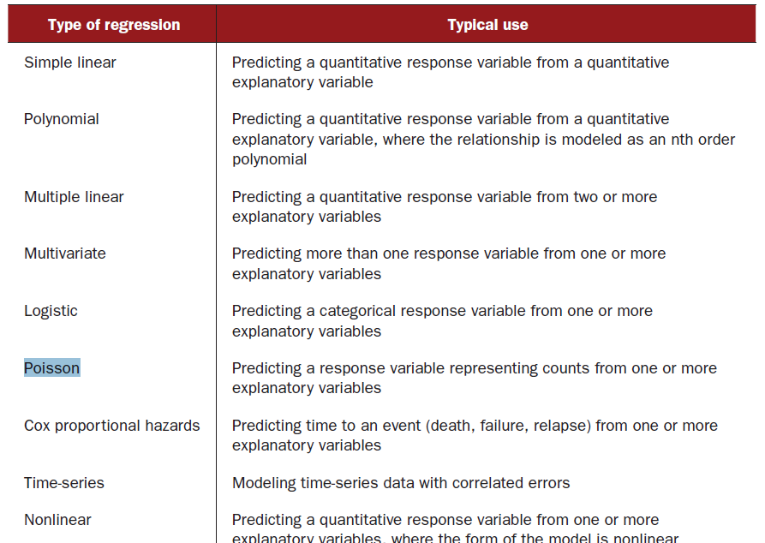
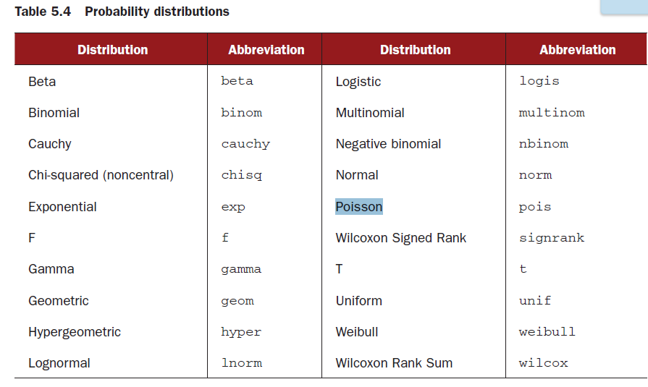
Outcome in regression models

Slide 17
R syntax
poisson.model = glm(Y~x1+x2+…Xn,data=dataframe,
family=poisson(link=“log"))

Slide 18
Hypothesis testing in Poisson regression

Slide 19
Count

Slide 20
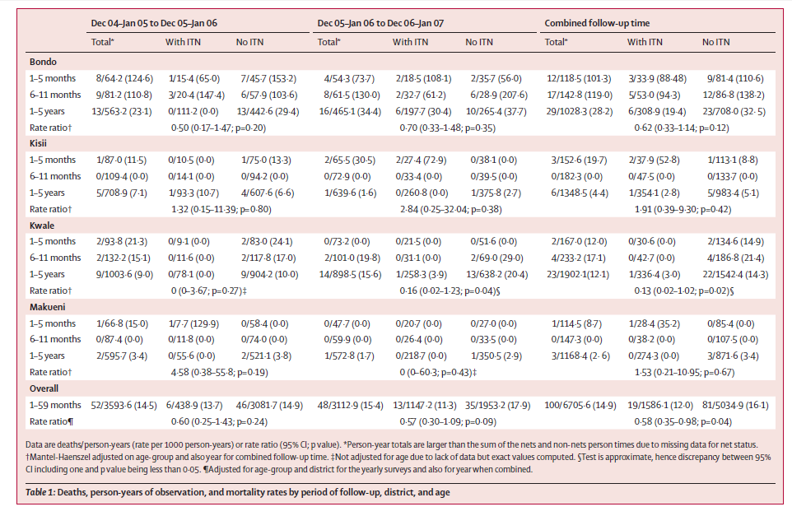
Rates

Slide 21
Hypothesis testing and test for linear trend in Poisson regression

Slide 22
Recap of time-to-event (TTE) data

Slide 23
Flow chart for regression models
Outcome variable continuous or dichotomous?
continuous
dichotomous
Predictor variable categorical?
Time-to-event available ?
No
Yes
(e.g. groups)
No
Yes
Multiple linear
regression
ANCOVA
Multiple logistic
regression
Cox proportional
hazards regression

Slide 24
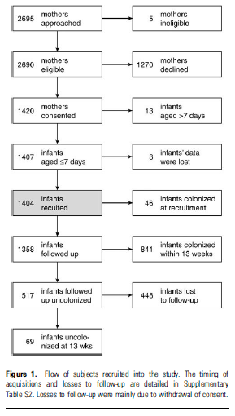
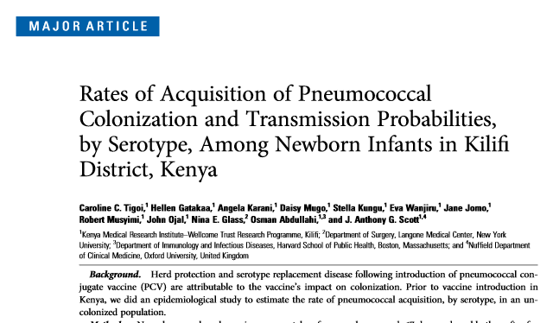
Recap time-to-event data

Slide 25
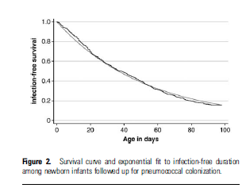
Time to event (TTE)
Event: Pneumococcal acquisition among infants
➔ Time-to-event also available
Statistical Modeling Approaches
Logistic Regression:
Would do separate rate comparisons at distinct time points
➔ % with Pneumococcal acquisition by 60days, by 90 days …
Cox Proportional Hazards Regression:
➔ Comparison of survival curves across all time points
> Uses more information: Event (Yes/No), TTE
> More powerful in identifying systematic differences

Slide 26
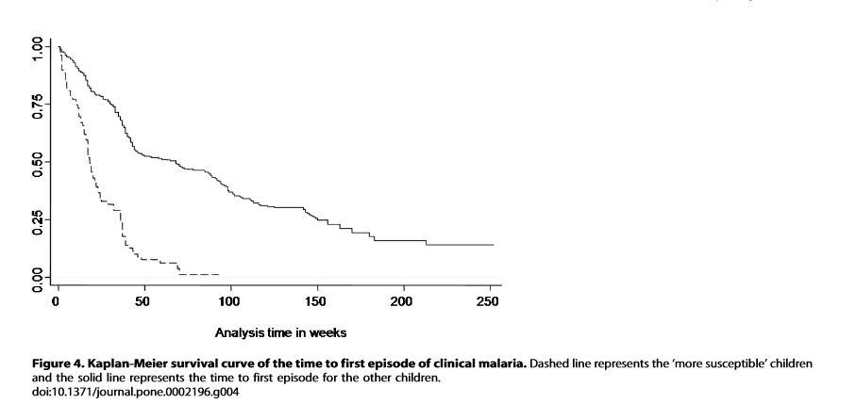
Time to first episode of malaria

Slide 27
Censoring
Generally, three reasons why censoring might occur:
A subject does not experience the event before the study ends
A person is lost to follow-up during the study period
A person withdraws from the study
These are all examples of right-censoring

Slide 28
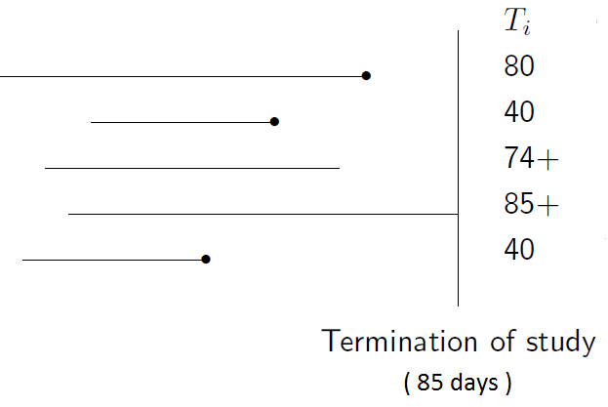
Censoring
➔ Most typical to consider start of time-to-event “clock” as t=0
Censored
Non-Events

Slide 29
Classical analysis of rates

Slide 30
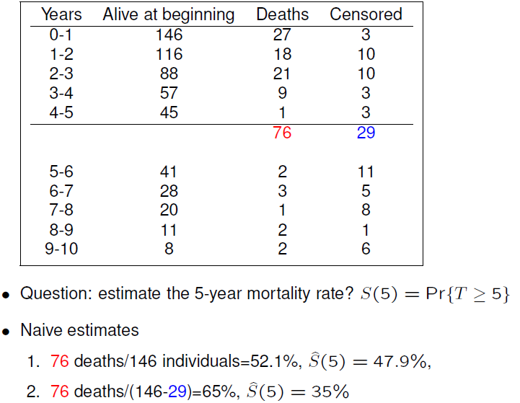
Life Tables

Slide 31
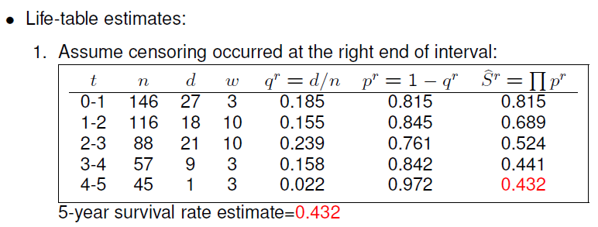
Life Tables

Slide 32
Life Tables
146-30
Censored observations are counted in the denominator of those
“at risk” until they are censored

Slide 33
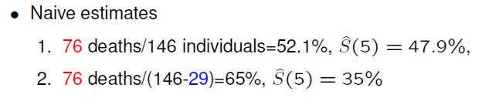
Life Tables
146-30
Censored observations are counted in the denominator of those
“at risk” until they are censored

Slide 34
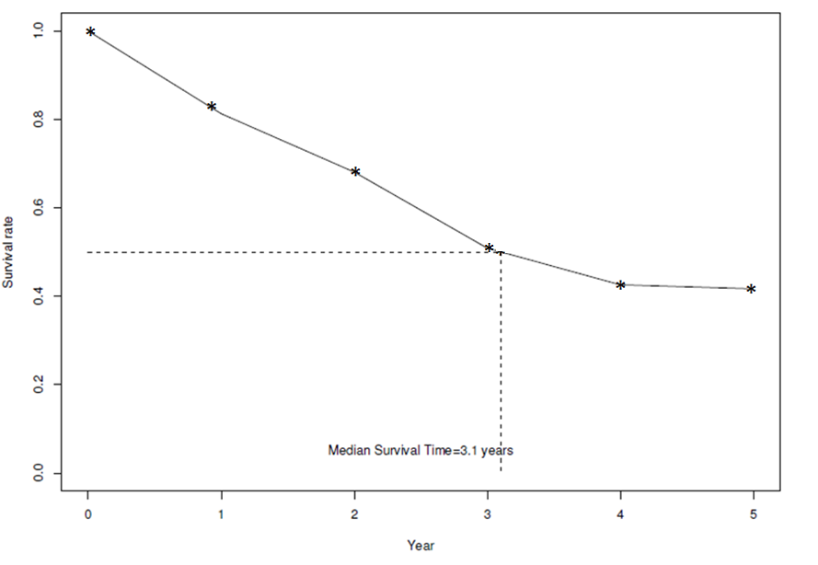
Survival Curve

Slide 35
Functions of interest in R
Survival object: Surv
Kaplan-Meier estimates: survﬁt
The log-rank test: survdiff
The Cox proportional hazards model: coxph
The Accelerated failure time model: survreg
Relevant R packages: survival, survcomp, HMISC, Design, MASS

Slide 36
Practical analysis of events over time

